Slide 1
Cyclistic Bike Share Analysis
Made By -
Protyoy Pritam Goswami

Slide 2
What are we trying to find?
How Casual Riders and Annual Members use Cyclistic Bike Hire differently?

Slide 3
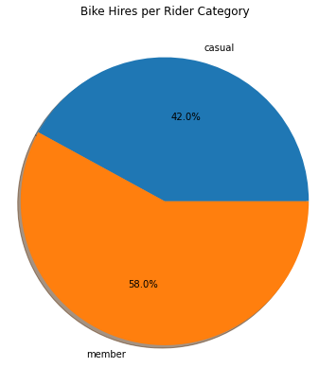
No. Of Bike Hires by Rider Category
Too many Casual Riders
42% of total bike hires belongs to casual riders.

Slide 4
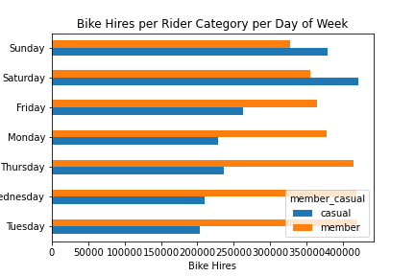
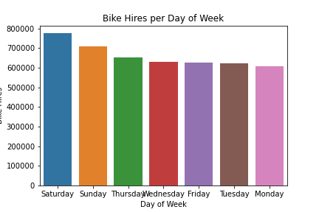
No. Of Bike Hires by Day of Week
Casual rides on Weekends
Casual Riders preferably ride on weekends while Annual Members ride regularly but especially on Tuesday, Wednesday and Thursday.
Overall, weekend days are our high demand days.

Slide 5
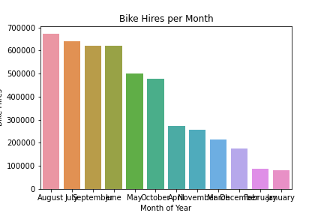
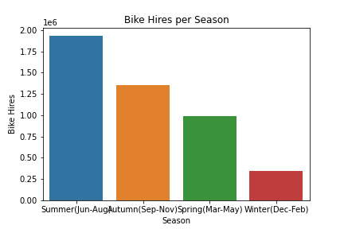
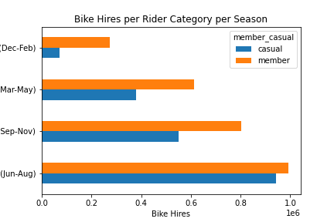
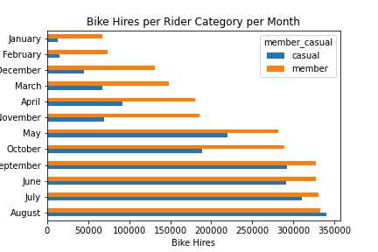
No. Of Bike Hires by Month/ Season
Cool rides in Summer
Summer is the most preferred season by our riders and Winter is the least.
Casual riding drops by a huge margin in Winter.

Slide 6
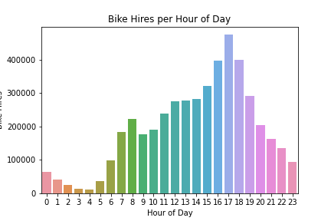
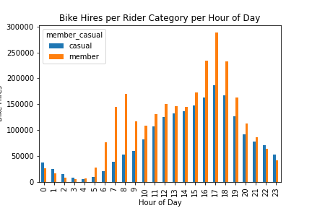
No. Of Bike Hires by Hour of Day
Stress free rides after work
Afternoon hours (4-7 pm) are high demand hours for both type of riders.
There is also a high demand in riding for members in the morning office going hours. Also riding on weekdays was high for annual members which may indicate that they use bike share service to go to work.

Slide 7
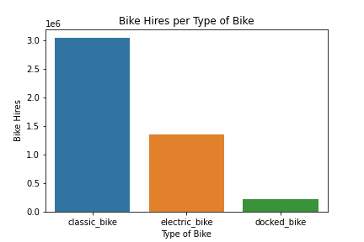
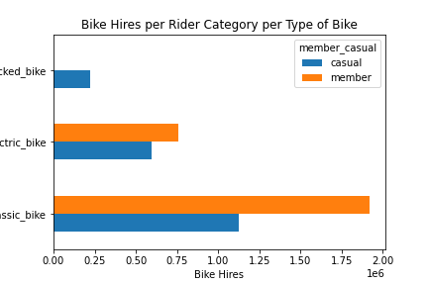
No. Of Bike Hires by Type of Bikes
Classic is more classy
Both casual and annual riders prefer to ride classic bikes.
Annual members did not ride docked bike at all

Slide 8
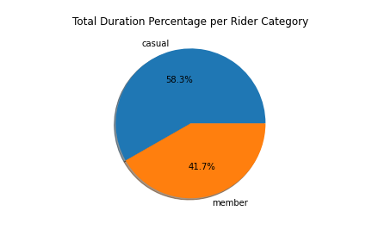
Ride Duration by Rider Category
Casual Riders rode Longer!
Casual Riders rode for 58% of total ride duration while annual rider rode only for 42%,
It reflects the need to convert casual riders into annual members.

Slide 9
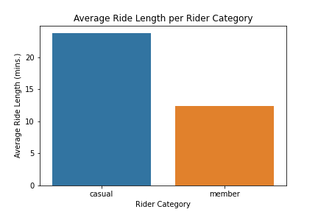
Avg. Ride Duration by Rider Category
Long carefree casual rides
Casual riders usually hire bikes for longer duration than annual members.

Slide 10
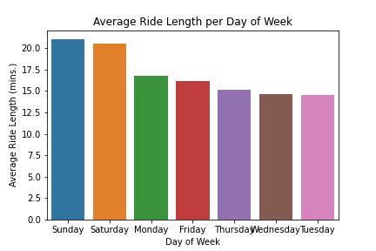
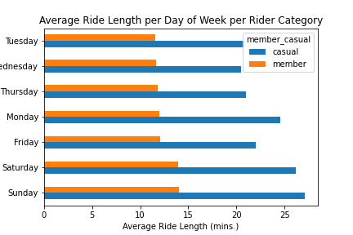
Avg. Ride Duration by Day of Week
Long rides on Weekends
Both casual and annual riders have greater average ride duration on weekends.
Casual riders surpasses annual members by average ride hours on all days.

Slide 11
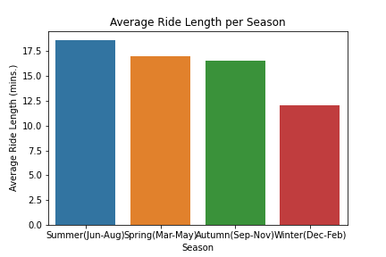
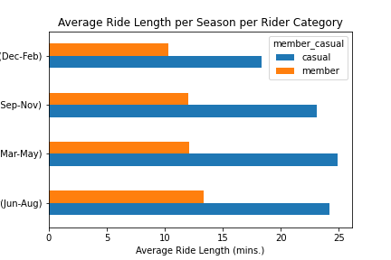
Avg. Ride Duration by Season
Summer is soothing
Both casual and annual riders have highest average ride duration in Summer and lowest in WInter.
Casual riders surpasses annual members by average ride duration in all seasons.

Slide 12
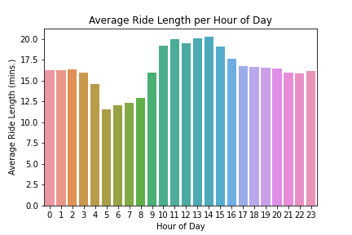
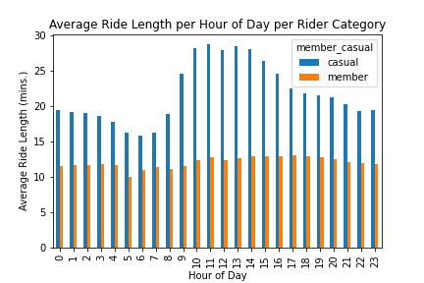
Avg. Ride Duration by Hour of Day
Long day hours
Casual riders tend to go for longer rides in late morning/noon time.
For annual members, average ride duration is almost same throughout whole day.

Slide 13
Summery What difference did we find between usage of casual riders and annual members?
Casual riders ride lesser but longer than annual members. But on weekends and night hours, they surpass annual members.
Many annual members use bike share to travel to their workplaces.
Classic bike is most popular. However annual members do not use docked bike at all.

Slide 14
Top 3 Recommendations to convert casual riders into annual members
Show casual riders how they can save money on long rides by opting for annual membership.
1
Run special ad campaigns on weekends, summer season and afternoon/ evening hours.
2
Show environmental and monetary benefits of using Cyclistic Bike Share annual membership service for work commute to casual riders.
3

Slide 15
Thank you

